Slide 1

What a Way to Live
1:12 – 20
Week 32
12 October 2022

Slide 2

Philippians chapter overview
Paul begins this epistle with his customary salutation followed by an expression of thanksgiving and prayer. He shares that the church at Philippi had been a source of great joy to him by virtue of their fellowship with him in the proclamation of the gospel (1-5).
Confident that God will complete the work He began in the Philippian Church, Paul prays that their spiritual growth will continue (6-11).

Slide 3
Philippians chapter overview
Additionally, Paul says that his circumstances at Rome have actually been for the furtherance of the gospel, despite imprisonment and opposition by false brethren. He is confident that everything will turn out all right, and that he will even come to them again (12-19).
However, it is not without mixed emotions that Paul is torn between a desire to be with Christ and a realization that to remain in the flesh is more needful for them (20-26).

Slide 4
Philippians chapter overview
Paul’s desire is that whether absent from or present with them, he may hear they are conducting themselves worthy of the gospel, by standing fast in one spirit and one mind for the gospel and by not allowing themselves to be intimidated by any adversaries (27-28).
Finally, Paul encourages them to take comfort in knowing that, like himself, they have been granted the honor not only to believe in Christ, but also to suffer for His sake (29-30).

Slide 5


Slide 6

“What a Way to Live”

Slide 7
Philippians 1:12 – 20
Holocaust survivor Viktor Frank observed, “Everything can be taken from a man but one thing: the last of the human freedoms—to choose one’s attitude in any given set of circumstances.”
If we pursue happiness instead of choosing joy, we will become, as Viktor Frank put it, “playthings of circumstance.” Our inner peace will be tossed back and forth according to the whim of events beyond our control. But if we choose our attitude—the one basic freedom that can’t be taken away from us—we can choose joy even in the midst of the cruelest of circumstances.

Slide 8
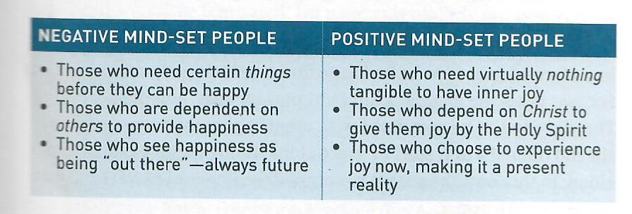
Philippians 1:12 – 20
Truth of the matter – joy does not come from without, but from within. A life of calm, peaceful satisfaction, a positive attitude, a contented spirit—these aren’t dependent on circumstances but on our mind-set. There are two types of people:

Slide 9
Philippians 1:12 – 20
It’s not enough, though, simply to say, “I choose to be happy. I choose joy.” The Bible’s not a self-help manual to stir up your inner power of positive thinking. That’s rubbish. When talking about a “positive mind-set,” we are talking about the joyful disposition that comes from the renewal of the mind by the Holy Spirit (Rom. 12:2). That’s the internal work of God. But God also uses external means to reinforce His work in us, like when we intentionally set our minds on the things of God (Phil. 4:8).
In Philippians 1:12-20, Paul embodies the decision to live a joyful life in spite of troubling circumstances. Remember who it is we’re talking about. He wanted to go to Rome as a preacher. Instead, he went as a prisoner.

Slide 10
Philippians 1:12 – 20
As a Roman citizen Paul had the right to be treated with fairness and justice. Instead, he had been mistreated, falsely accused, and unjustly arrested. On top of all this, during his journey to Rome he was shipwrecked!
If anybody had a right to look at the world through dim lenses, complaining that he had been victimized, it was Paul. But even through all this, he did not complain. He was confident, despite hardship (1:12-14); joyful, in spite of others’ ill will (1:15-18); and hopeful, regardless of uncertainties (1:19-20).

Slide 11
Philippians 1:12 – 14
¹²But I want you to know, brethren, that the things which happened to me have actually turned out for the furtherance of the gospel, ¹³so that it has become evident to the whole palace guard, and to all the rest, that my chains are in Christ; ¹⁴and most of the brethren in the Lord, having become confident by my chains, are much more bold to speak the word without fear.

Slide 12
Philippians 1:12 – 14
In light of the sequence of events leading to his imprisonment, Paul was convinced that his circumstances had turned out “for the greater progress of the gospel” (1:12). Don’t you love that! There’s no pouting, no “woe is me” mentality. Rather than viewing his chains as intolerable restrictions, Paul saw them as God-appointed megaphones to get the message of the gospel into the imperial barracks.
Because of his imprisonment under the ever-watching eyes of Roman soldiers, the cause of Christ had become know “throughout the whole praetorian guard” (1:13). In other words, the gospel had penetrated into places it never would have without Paul’s “tragic” arrest.

Slide 13
Philippians 1:12 – 14
Think about it. With each changing of the guard came a new opportunity for sharing Christ, for telling his compelling story of conversion. How he was once a persecutor of Christians. How he had met the Lord Jesus face-to-face. How he had gone from enemy to emissary overnight. For two years, the Roman guards heard Paul pray, preach, and dictate letters.
They listened as he conversed with others about the consequence of sin and offered a new start by grace alone through faith alone in Christ alone. In this way, the gospel penetrated the imperial barracks like an arrow through armor.

Slide 14
Philippians 1:12 – 14
None of this could have happened had Paul chosen despair instead of joy. Instead of asking, “Why did this have to happen to me?” he asked, “How has this resulted for God’s benefit?” He rejoiced that the unfair circumstances that were brought about by those trying to silence him ended up amplifying the proclamation of the gospel far and wide.
His own positive attitude during imprisonment encouraged those who were still free. They could put up with more, suffer more, speak out more . . . and spread the gospel with far more courage than they had before (1:14).

Slide 15
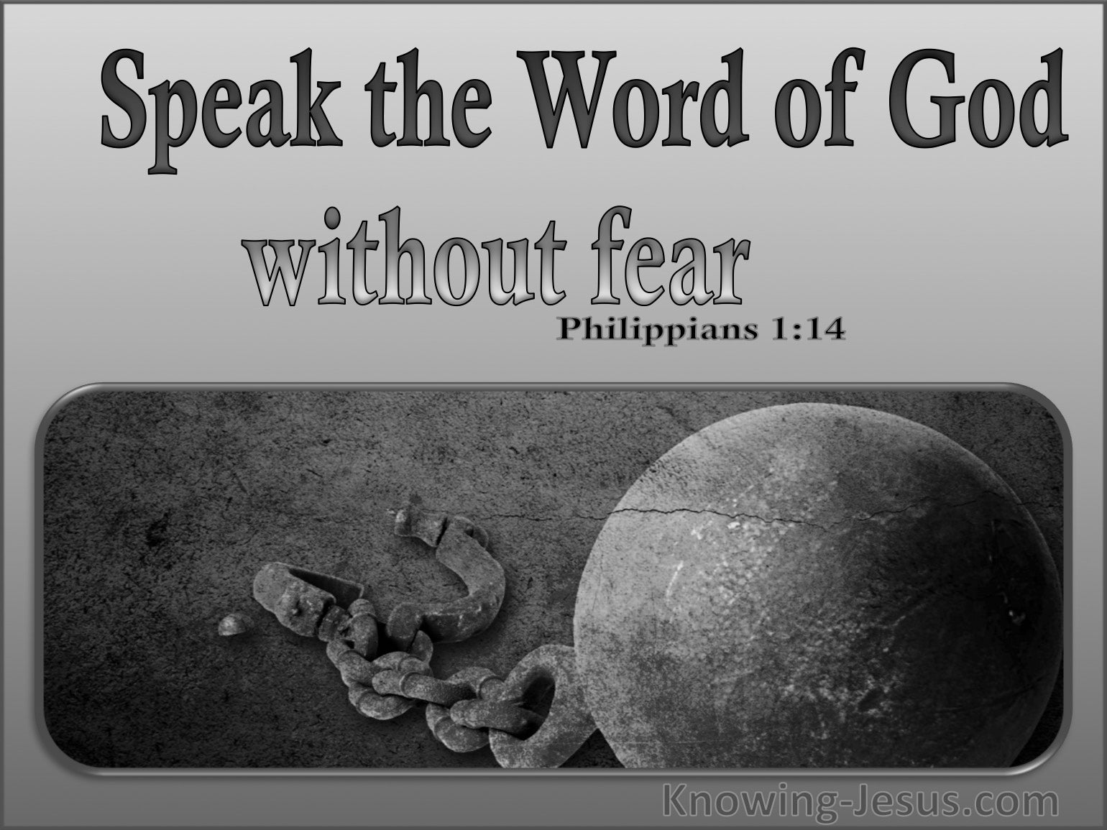

Slide 16
Philippians 1:12 – 14
What Paul’s enemies had intended as a deathblow to his ministry had breathed new life into the church worldwide. We can only wonder if the words of the ancient patriarch Joseph ever entered Paul’s mind as he reflected on his circumstances with a smile: “As for you, you meant evil against me, but God meant it for good in order to bring about this present result, to preserve many people alive” (Gen. 50:20).

Slide 17
Philippians 1:15 – 18
¹⁵Some indeed preach Christ even from envy and strife, and some also from goodwill: ¹⁶The former preach Christ from selfish ambition, not sincerely, supposing to add affliction to my chains; ¹⁷but the latter out of love, knowing that I am appointed for the defense of the gospel. ¹⁸What then? Only that in every way, whether in pretense or in truth, Christ is preached; and in this I rejoice, yes, and will rejoice.

Slide 18
Philippians 1:15 – 18
Besides being confident even in the midst of hardship, Paul was also joyful in spite of what other people did to harm him. While Paul was stuck under house arrest, he had to count on others to carry on the work of spreading the gospel beyond the cities he and other apostles had already reached.
Many had picked up the torch and were bearing it honorably in the same spirit of self-sacrificial love as Paul had. I think of Timothy, Luke, Mark, and others who were faithful to Paul’s cause. But with Paul stuck in a pit stop, his absence also encouraged others to infringe on his mission field with less honorable motives.

Slide 19
Philippians 1:15 – 18
Some began preaching the gospel not because the love Christ compelled them, but because they saw a gap in the market and an opportunity to do what Paul had done and to get a little of the glory they thought Paul had received.
As Paul’s faithful friends visited him in his rented home and saw the unbelievably optimistic attitude he had, they may have become a little frustrated. Here Swindoll employs a little creative license:
Paul smiles widely, eyeing the Roman guard sitting nearby. “Isn’t it amazing how God’s working through all this?” He waves his hand around his home then gestures toward the soldier. “Did you hear what Claudius here said? The guards were talking about Jesus last night! The guards!”

Slide 20
Philippians 1:15 – 18
“Huh?” Luke lifts his pen from the paper on which he had been writing since lunch, ignoring everything that had been going on all afternoon. “Oh, yeah. Sure, that’s true.” He sets down his pen. “But think of all the places where you could be taking the gospel.” He points down at his paper. “I’ve been writing this account for that court official, Theophilus, all about the adventures we’ve already had. It’s so amazing! So thrilling! I know there’s more ahead. You still haven’t made it to Spain like you wanted. But you’re stuck here. We have to get you out of Rome as soon as we can. I have this plan—”
Paul interrupts Luke with a wave of his hand. “Luke, so many other workers are rolling up their sleeves and digging in. I think being ‘stuck’ here may be a good thing. It’s actually gotten people off their seats and serving.”

Slide 21
Philippians 1:15 – 18
“I feel like a lot of those guys were a little intimidated by me. Now they’re boldly preaching in my place!”
Luke takes a deep breath. “About that …”
“Yes?”
“Well,” Luke says, “you need to know that there are some, well—” he pauses, searching for the right word. “Let’s just call them ‘less than sincere’ people preaching out there. Not that they’re trying to make a name for themselves. Mark thinks they’re driven by envy—envy of you and of each other. They’re actually acting like it’s a big competition. To see who can plant more churches. I even think a few might be trying to nudge you out a little while you’re stuck here. All the more reason for us to figure out a way to get you out as soon as possible.”

Slide 22
Philippians 1:15 – 18
Paul lets out a long sigh and responds, “Hmmm. You know what, Luke? So what if some are preaching with wrong motives? So what if some are a little too interested in themselves? So what if there are some who are taking shots at me while I’m out of pocket? None of that matter. What matters is this.”
Paul leans in and looks Luke right in the eyes. “Christ is being preached, even more than when I was out there myself. And that thought alone is enough to give me joy!”

Slide 23
Philippians 1:15 – 18
Although we have no official record, a conversation like this could have taken place. We do know that Paul had been made aware of some fresh contenders out in the field—some preaching Christ “from envy and strife” and “selfish ambition,” while others preaching with pure motives (1:15-17). In either case, Paul concedes, Christ is being preached (1:18).
But isn’t this a contradiction in Paul’s teaching? Didn’t he strongly condemn those who were preaching a “different gospel” in Galatia (Gal. 1:6-9)? Is he now fine with false preaching? No! In Galatians, the apostle was denouncing those who garbled the gospel message into a message of works. They were preaching heresy.

Slide 24


Slide 25
Philippians 1:15 – 18
In Philippians, he’s rejoicing that despite the impure motives of some, the authentic good news about the true Jesus is still being proclaimed.
A heretic with sincere motives is still preaching a gospel that has no power to save anyone. But a presentation of the truth, even by those who aren’t living in accordance with it, still has the power to bring a person to faith. Never forget: It’s the work of the Holy Spirit, not His empowered preachers, that saves people.

Slide 26
Philippians 1:19 – 20
19For I know that this will turn out for my deliverance through your prayer and the supply of the Spirit of Jesus Christ, ²⁰according to my earnest expectation and hope that in nothing I shall be ashamed, but with all boldness, as always, so now also Christ will be magnified in my body, whether by life or by death.

Slide 27
Philippians 1:19 – 20
So far we’ve seen Paul model for us a particular lifestyle by his remaining confident through hardship (1:12-14) and by his choosing to be joyful in spite of others who might otherwise rob him of reasons to rejoice (1:15-18). Now, Paul show us how to be hopeful, regardless of uncertainties (1:19-20).
With the gospel spreading and people proclaiming Christ, not simply in spite of Paul’s imprisonment but because of it, Paul was greatly encouraged. This helped boost his trust in God instead of deflating his confidence. Yes, Paul’s future was filled with countless uncertainties. Certainly, some reminded Paul that his own legal situation in Rome could conceivably take any number of negative—even tragic—turns.

Slide 28
Philippians 1:19 – 20
But Paul chose to be hopeful in spite of the uncertainties. He was confident that the Philippians’ prayers and the Lord’s provision would ultimately result in his deliverance, likely referring to a literal release from prison (1:19).
But what if he wasn’t set free? What if his opponents somehow rigged the system, like they had done in the case of Jesus Christ? What if Paul faced the same path as his Lord? Despite these uncertainties, his hope remained. Paul was unafraid and unashamed. Whether he lived or died, he knew that Christ would be exalted (1:20).

Slide 29
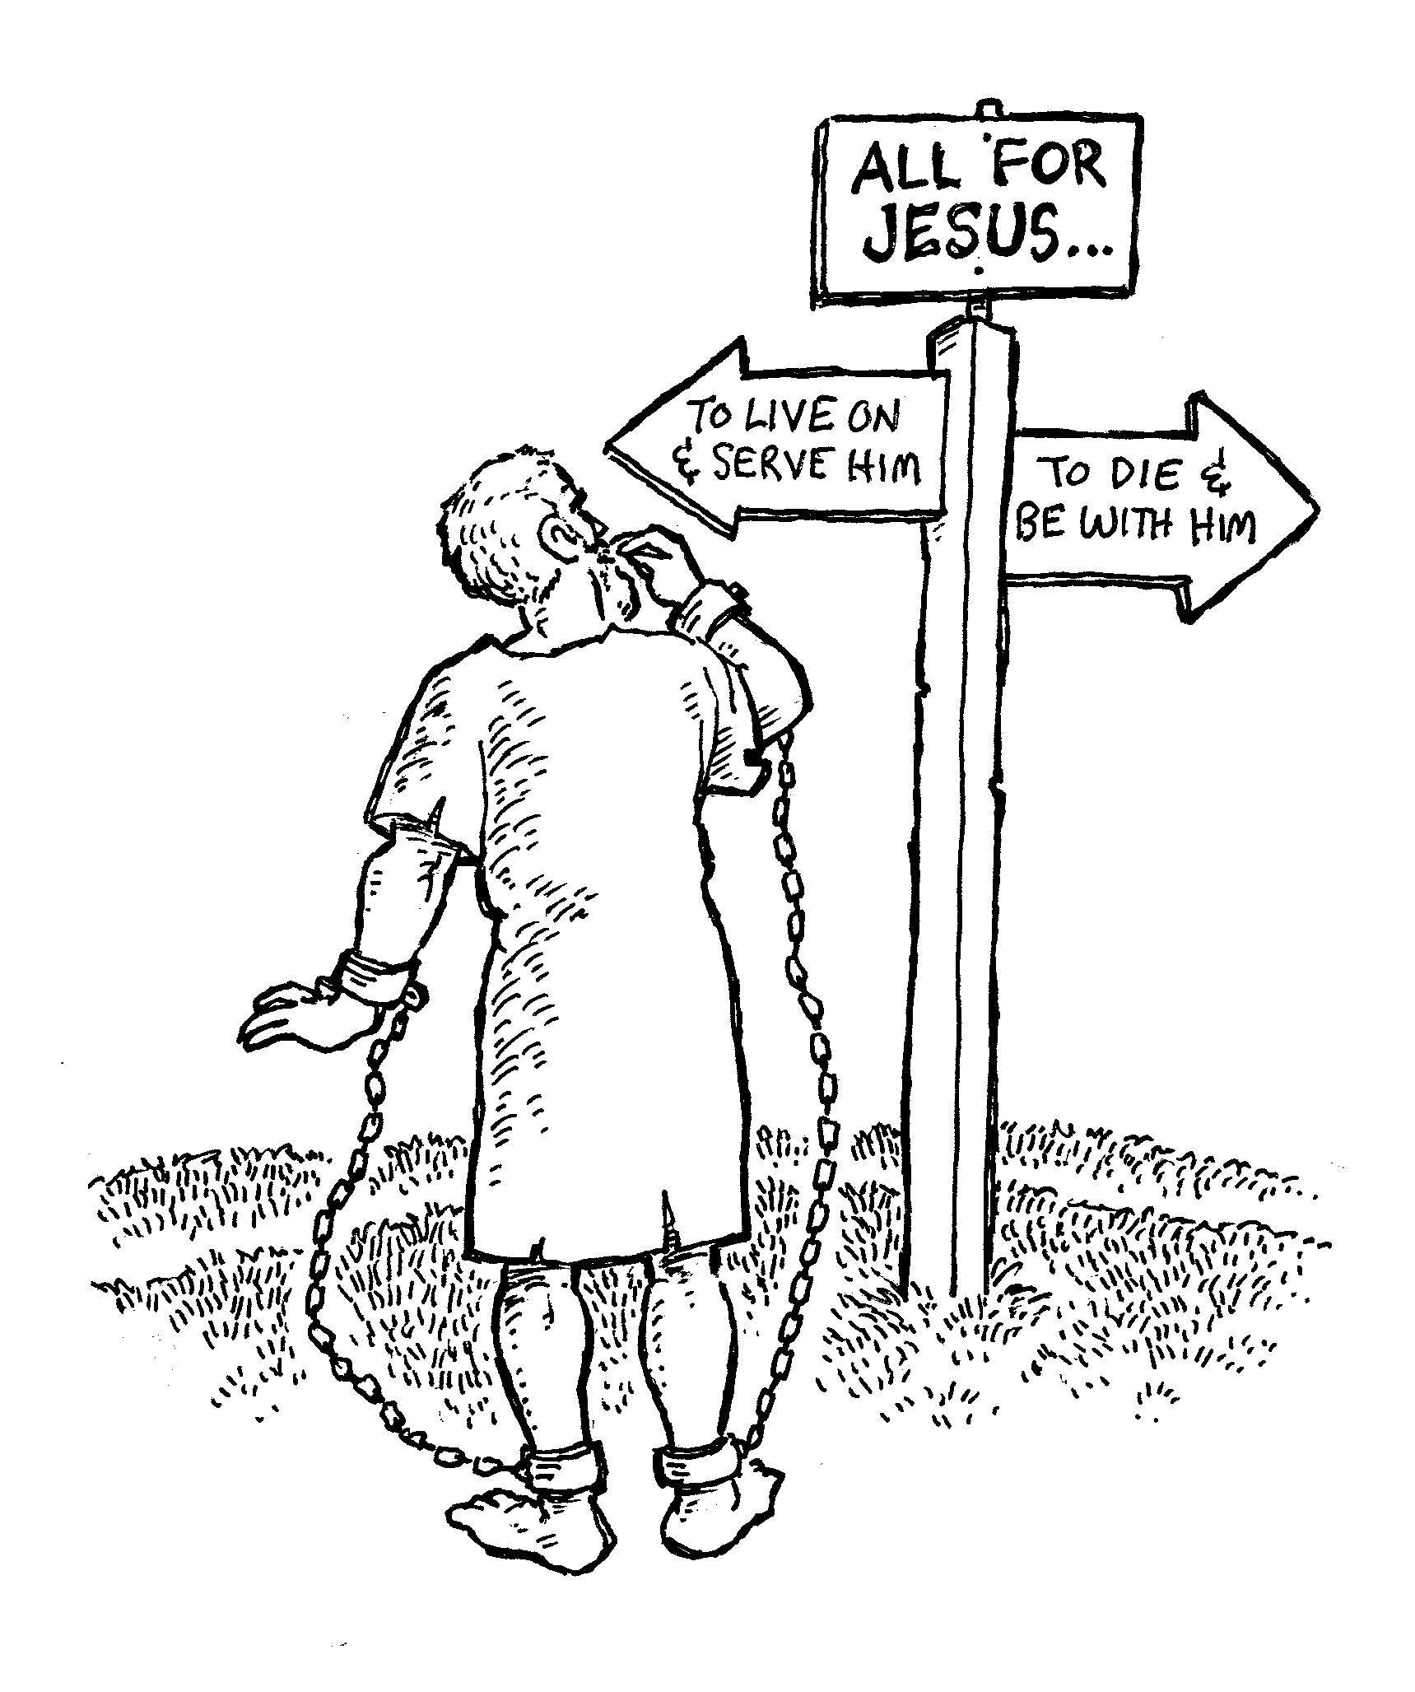

Slide 30



Slide 31
NEXT CLASS – 26 October 2022
Book of Philippians
Before next class, read the below verses in the NKJV and in one other versions of the Bible, i.e., NIV, NRSV, KJV, CEV, etc …
Chapter 1:21 – 30
“Between a Rock and a Hard Place”

